Slide 1
WELCOME

Slide 2
Smart and Ultra-Sound Car Parking System.

Slide 3
‘
Mohd. Rasadin
rasadin.ewu@gmail.com

Slide 4
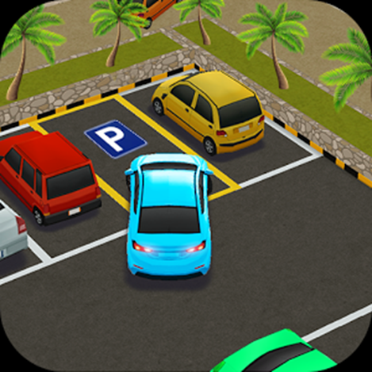
OBJECTIVES
To build a Smart Parking System using Arduino and Ultrasonic Distance Sensor.
To help the car drivers in parking time.
To know the use of HC-SR04.
To find out a smart way of parking.
To give extra benefit to the car drivers.

Slide 5

Abstract
In this project, we will build a smart parking system using Arduino and Ultrasonic Distance Sensor. Our project will help the car drivers in parking time. The basic premise is that the closer a reversing car gets to an object, the greater the frequency of beeps from a buzzer. Eventually if the car gets too close to an object, the buzzer will remain on continuously. Not only buzzer but also LED will give warning and LCD will give the distance value.

Slide 6
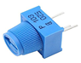
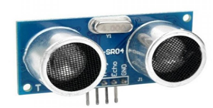

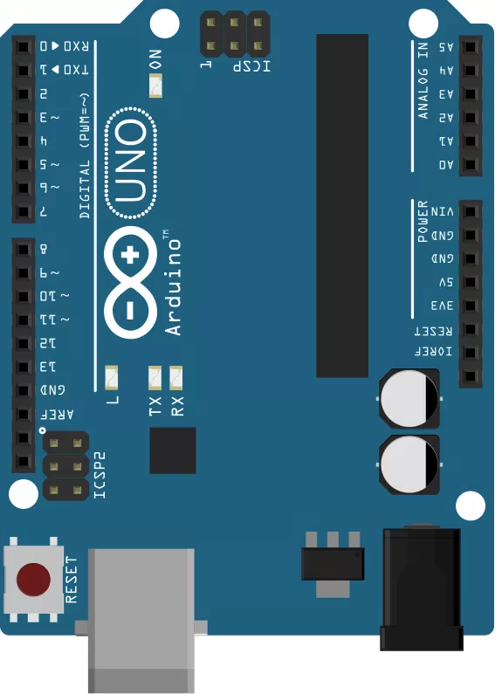
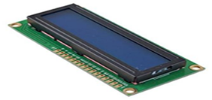
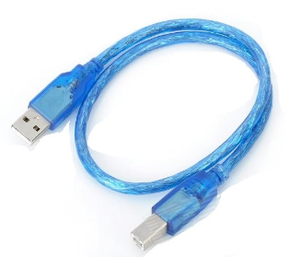
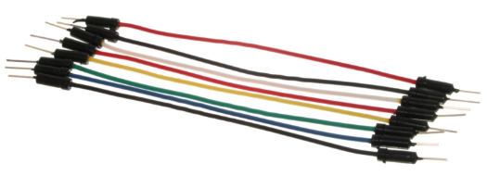
EQUIPMENT
Ultrasonic Sensor HC-SR04.
Arduino Uno.
Arduino Software.
16X2 Character LCD.
Buzzer.
220 ohm Resistor.
10K POT (Potentiometer).
Colored LED’s.
Wires and Breadboard.

Slide 7
Circuit Diagram
Circuit Diagram Part 01

Slide 8
Circuit Diagram Part 02

Slide 9
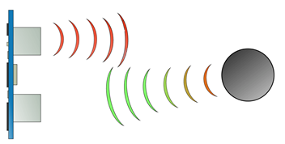
How It Works
It emits an ultrasound at 40 000 Hz which travels through the air and if there is an object or obstacle on its path It will bounce back to the module. Considering the travel time and the speed of the sound you can calculate the distance

Slide 10
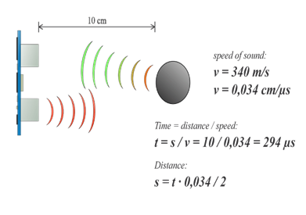
How It Works
For example, if the object is 10 cm away from the sensor, and the speed of the sound is 340 m/s or 0.034 cm/µs the sound wave will need to travel about 294 u seconds. But what you will get from the Echo pin will be double that number because the sound wave needs to travel forward and bounce backward. So in order to get the distance in cm we need to multiply the received travel time value from the echo pin by 0.034 and divide it by 2.

Slide 11
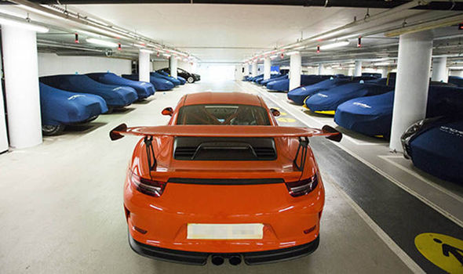
RESULT AND ANALYSIS
When any car enter parking area our project will start to work. At first HC-SR04 sensor take the value from the object or car. Firstly buzzer will give audio sound. This sound indicate that there are car which is entering in the parking area. When the car start to move close the wall or another car our led will be on. The led will maintain the serial. The serial is green, white, blue, yellow and red. Every color has its own warning. With led our buzzer also continuously giving audio sound. When our target car going very much close of wall or another car all the led sound will be on. Not only sound and led warning driver can also see the distance value from the wall or other car. Our 16X2 LCD display give the distance values continuously.…..

Slide 12
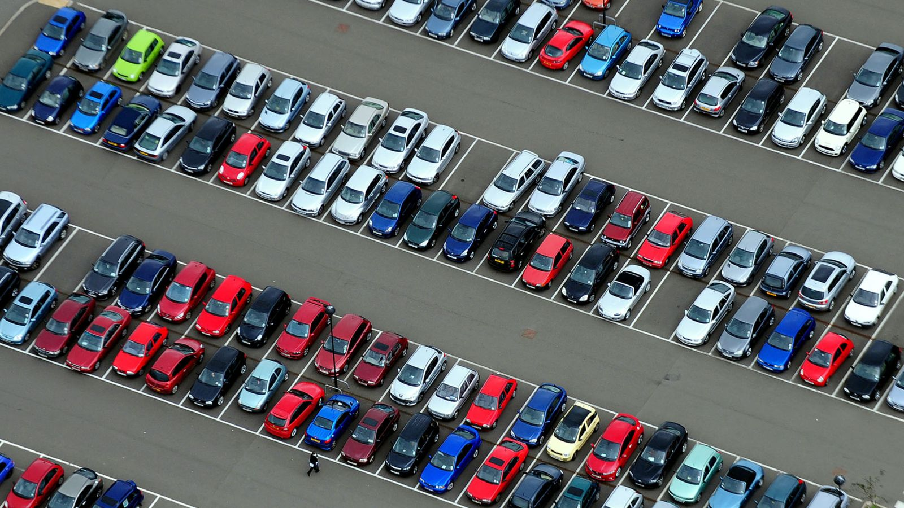
Any Question?

Slide 13



